Slide 1
The Impact of Population Density on Yelp Reviews
By: Carson, Alex, Niko, Kai
GenBus 760
Notes:
Kai

Slide 2
Hypothesis and Dataset Selection
Hypotheses:
Hypothesis 1: Higher Competition and Quality in High Density Areas
In areas of higher population density, businesses will have higher average ratings due to increased competition within the industry, leading to higher quality food and service to attract customers.
Hypothesis 2: Higher Ratings in Tourist-Dense Areas
High-density areas like cities that attract tourists could have higher ratings on average due to novelty bias or lack of familiarity with local cuisine standards, leading to more positive reviews.
Datasets:
Yelp_Academic_dataset_busienss
population_by_zip_2010
Notes:
Kai

Slide 3
Cleaning Merging Processing
Data Cleaning
Identified and handled nulls, missing rows, and invalid values.
Merging and Aggregation
Performed an Inner Join using ZIP code as the primary key.
Aggregated data to calculate metrics like average stars and population density.
Statistical Analysis
Created bins for population density using descriptive statistics.
Computed a 'Competition Index' (businesses per capita).
Refined Analysis
Repeated analysis using population density bins for deeper insights.
Notes:
Niko

Slide 4
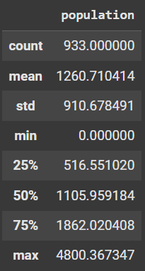
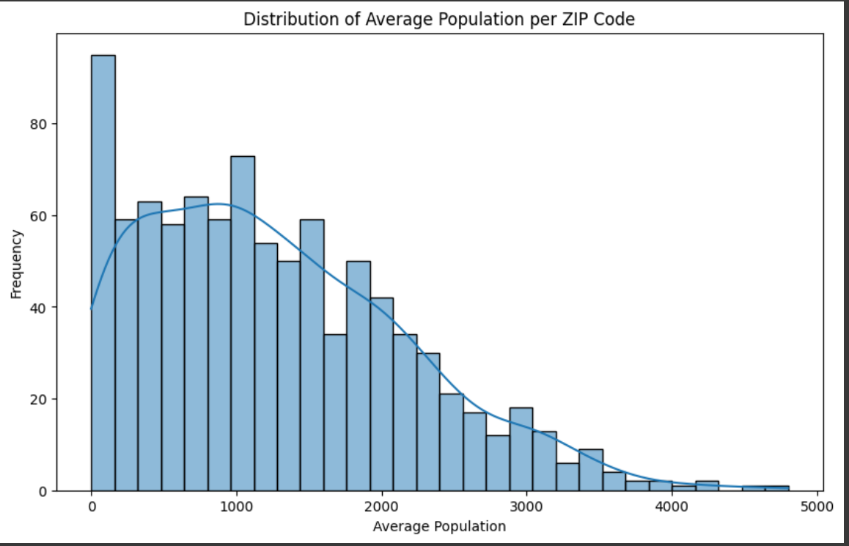
Distribution of Average Population Per Zip Code
The histogram and descriptive statistics provide an overview of the distribution of average population sizes across zip codes in the dataset.
Key Insights from Distribution:
The distribution indicates that most zip codes have smaller populations
A few outliers have significantly larger populations.
This analysis helps us define meaningful population density categories.
The distribution shows that most zip codes fall into lower-density categories, which may affect the average ratings and competition in these areas.
Notes:
Carson

Slide 5
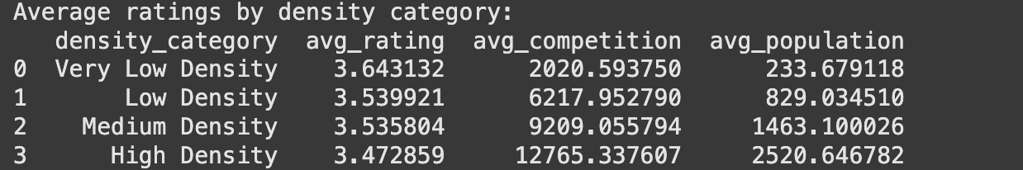
Average Ratings by Density
General Trends
Average rating decreases with increased population density
Average competition increased with increased population density
Competition: businesses per capita
Disagrees with Hypothesis 1: Decrease in average rating as average competition increases
No practical significant difference in average rating between low/medium density areas
Notes:
Alex

Slide 6
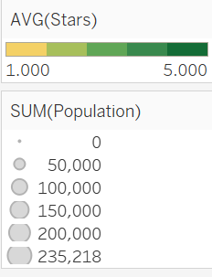
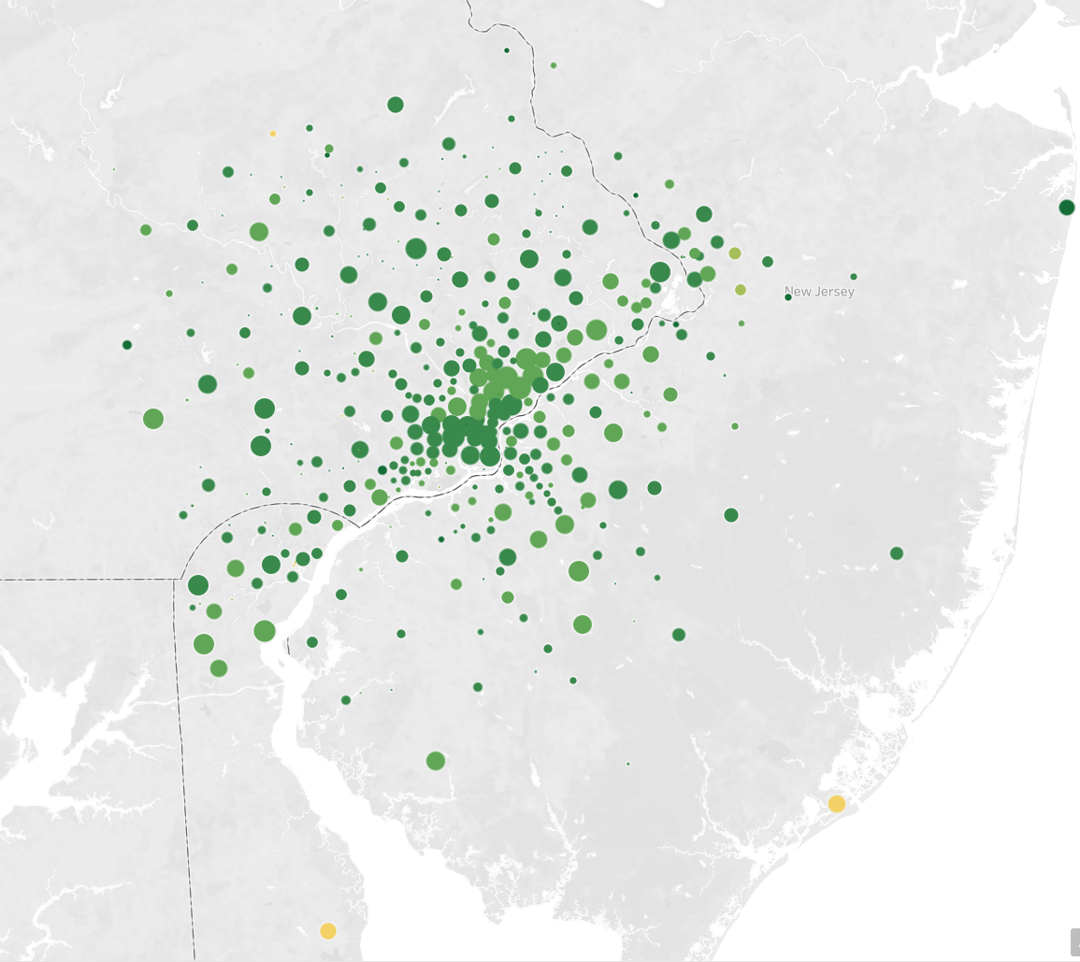
Tableau: Map
Data Representation:
Each point corresponds to a unique zip code.
Point Size: Represents the total population in the zip code
Point Color: Indicates the average star rating
Key Observations:
There is no clear visual pattern indicating that areas with larger populations have consistently higher or lower average ratings.
Ratings seem to vary widely regardless of population size, suggesting that other factors (e.g., business type, customer preferences, or competition levels) may play a larger role in determining average star ratings.
Notes:
Kai

Slide 7
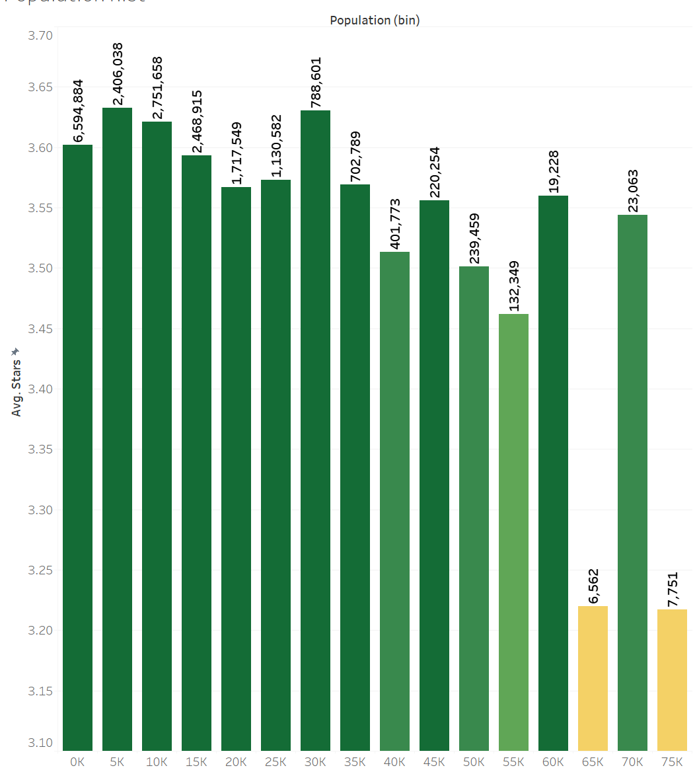
Tableau: Average Stars by General Population Bins
General Trends and Takeaways
Mid-sized populations tend to perform better
This could suggest a balance between demand and competition, leading to higher-quality services.
Optimal Density
Population bins between 15,000 and 40,000 represent an optimal range for business operations that offers a sweet spot for balancing supply and demand.
Business Strategies by Population
Business in highly populated areas may need to focus on differentiation and quality to maintain high ratings.
In less populated areas, businesses might need to attract customers through enhancing the customer experience.
Notes:
Niko

Slide 8
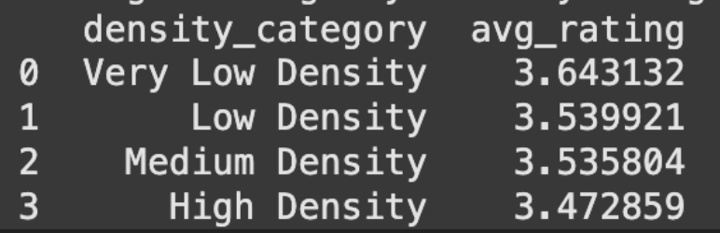
ANOVA Hypothesis Testing
ANOVA
Compares differences across population density groups
Null hypothesis (Ho): No difference in mean amongst different density groups
P-value: .0101
Less than .05: Reject the null hypothesis
Results
Statistically significant difference in average ratings between the population density groups
Minimal practical significance - up for interpretation
Reasoning
Statistically significance paired with practical insignificance likely due to large sample size
Notes:
Alex

Slide 9
Competition vs Average Rating Hypothesis Test
Spearman’s Correlation Test
This test measures the strength and direction of a relationship between two variables.
Correlation Coefficient (ρ): 0.0274
A value close to zero indicates a very weak or no relationship between competition and average ratings.
P-value: 0.4024
The p-value is greater than the significance threshold of 0.05, meaning we fail to reject the null hypothesis.
There is no statistical evidence to suggest a significant correlation between competition and average ratings.
Implications:
Businesses in high-density areas may not necessarily deliver better quality, even with greater competition.
Other factors (such as type of business, customer demographics) may have a stronger influence on ratings.
Notes:
Carson

Slide 10
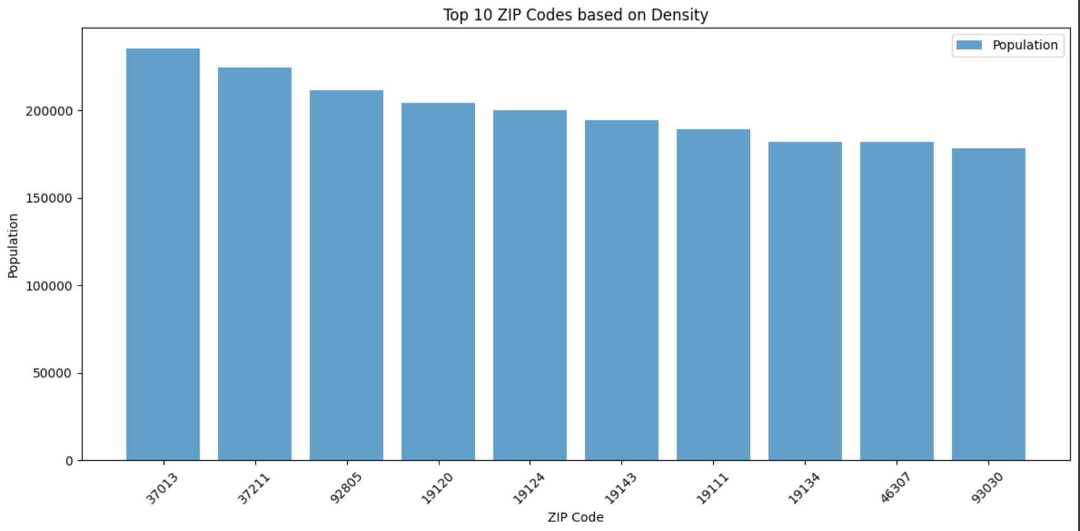
Top Performing Zip Codes By Density
235,218
224,265
211,203
204,312
200,073
194,547
189,270
182,205
181,857
178,116
Top Zip Codes: Nashville (x2), LA (x2), Philadelphia (x5), Indiana
Notes:
Niko

Slide 11
Results Summarized
Population Insights:
Most ZIP codes have small populations, with a few high-population outliers influencing density comparisons.
Key Trends:
Mid-sized population areas tend to have slightly better average ratings.
High-density areas show more competition but don’t guarantee higher ratings.
Statistical Results:
ANOVA revealed significant differences in ratings across density groups (p = 0.0101), but practical significance is limited.
Spearman revealed no statistical evidence to suggest a significant correlation between competition and average ratings.
Conclusions:
Competition and density have limited direct impact on ratings; factors like business type and service quality likely matter more.
High-density businesses should focus on uniqueness, while low-density areas should prioritize customer experience.
Notes:
Carson

Slide 12
Further Study Considerations
Competition Hypothesis Consideration
Defined Competition as Businesses Per Capita - not most accurate definition
Potential Solution - join on another Yelp dataset with sector information (i.e. restaurants, shops)
Yelp Data was Clustered Geographically
Utilize a more expansive dataset
Expanding Upon Our Findings
Using APIs or web scraping to gather data
Narrowing the scope (i.e. specific states)
Comparing results across states or geographical clusters
Exploring what factors impacts each density bin
Notes:
Alex

